Slide 1
PVG Valves
Competition & Applications
PVG管夹阀竞争优势和应用实例
联系方式：西安圣辉科技发展有限公司
029-88330638

Slide 2
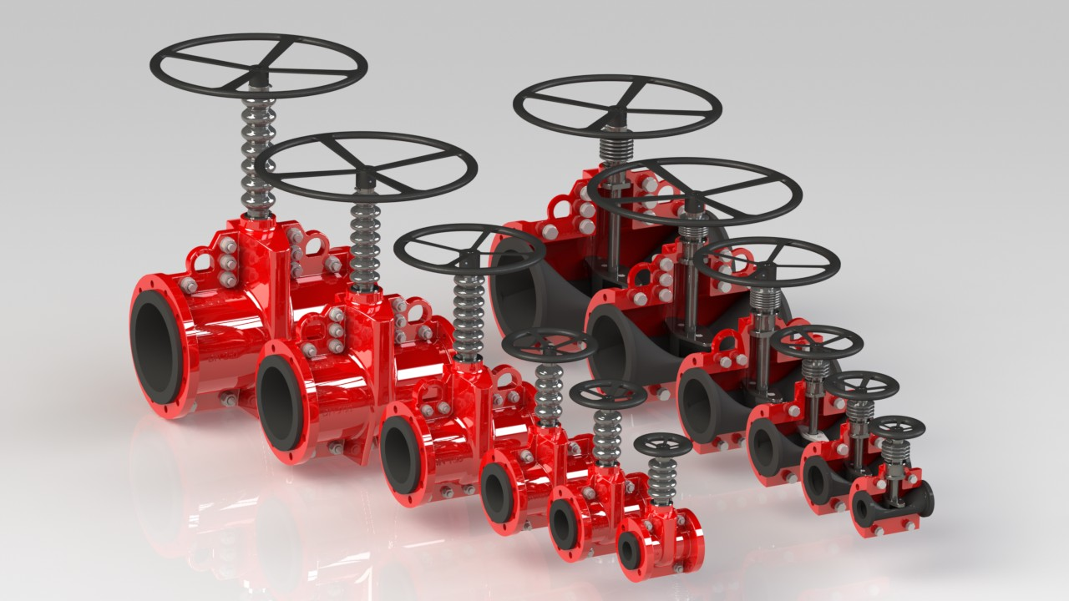
PVG Valves/新型PVG管夹阀

Slide 3
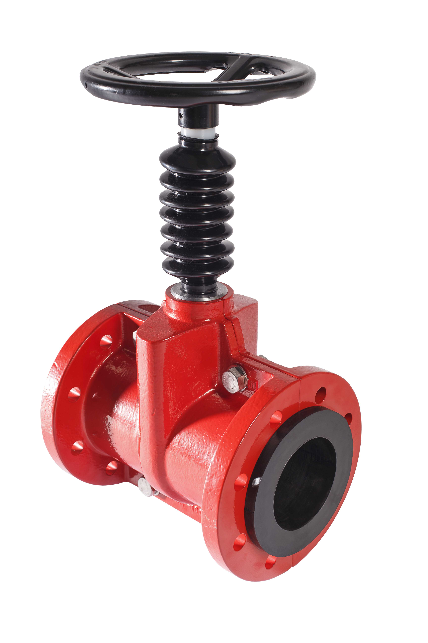
Flowrox PVG Valves
Features
100 % tight /100%关闭
Full bore /全管径流通
Only the sleeve is in contact with the medium
只有阀套与介质接触
Cast iron body, flexible sleeve as a core
铸铁阀体，柔软阀套
Opening tags on the upper side of the sleeve
在套筒上部有打开标识
Sizes: 50, 80, 100, 150, 200, 250 mm/尺寸
Operating temperature: 0°C to +110°C /工作温度
Operating pressure: 0 to 10 bar/压力0-10巴
Notes:
3

Slide 4
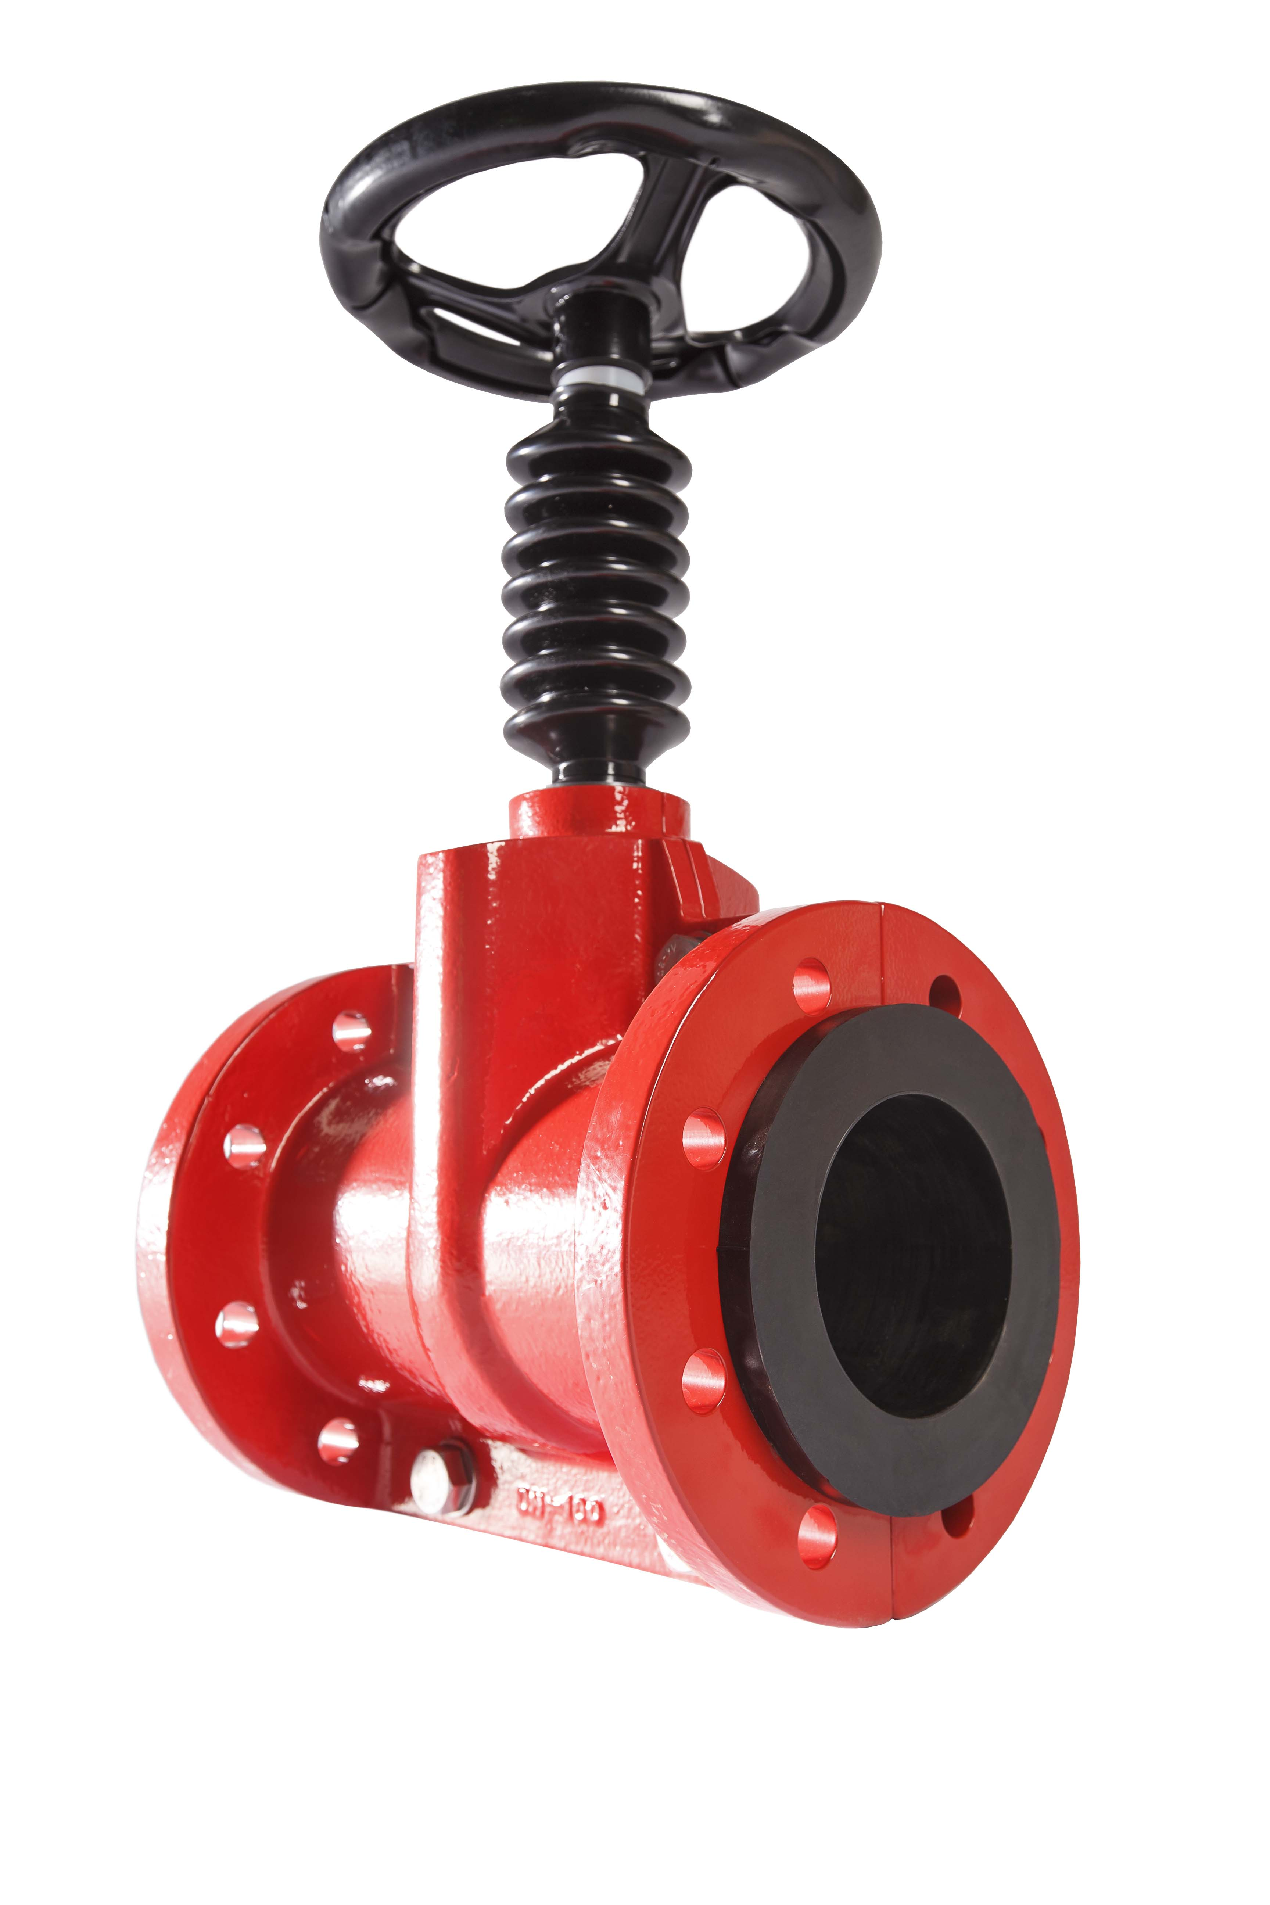
Benefits
Process benefits
No jamming or clogging/无干扰和堵塞
Full port design do not reduce system head pressure/全通径设计，无压降。
Higher temperature rate compared to PVEG
/适合高温度变化速率
Free flow of the medium/介质自由流动
Least pumping energy required/最小的泵损
Low maintenance costs/低维修成本
Long service intervals/长服务期间
Reduced cost of ownership/降低拥有成本
//与PVEG塑料阀相比：金属阀体、口径大、温度高（到110℃）、压力大（到10巴）
Notes:
4

Slide 5
Competition
PVG will compete against:/ 优于其它类阀门
Another pinch valves/PVEG管夹阀
Diaphgragm valves/隔膜阀
Globe valves/截止阀
Ball valves and even butterfly valves
/球阀和蝶阀
Flowrox will compete against local/ international valve manufacturers
Flowrox 敢于挑战国内国际阀门厂商

Slide 6
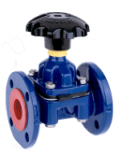
Diaphragm valves vs. PVG
和隔膜阀比较
Diaphragm valves | PVG valves
Diaphragm can be replaced with valve in line, with abrasive slurry body can wear and require replacement/磨损后整体更换 | Only sleeve needs to be replaced and with abrasive slurry lower cost of ownership /磨损后只换阀套，低成本
Diaphragm valves are not full bore and the weir causes turbulence wear and build up/不能全径流通，有湍流磨损 | Flowrox valves are 100% full bore /100%全通径流通
Diaphragm valves have limited differential pressure/ 压差受限 | Flowrox valves are 100% tight at the pressure rating of the valve /额定压力下100%全关闭
Diaphragm valves can be rubber/Teflon lined. In abrasive duties lining can de-laminate causing wear / corrosion /阀需加橡胶特氟龙内衬，否则会磨损锈蚀。 | Flowrox valves have longer life in abrasive duties /磨损状态下寿命长

Slide 7
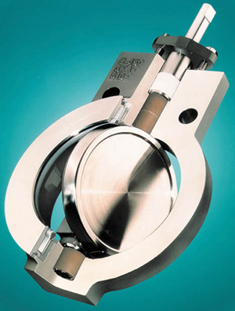
Butterfly valves vs. PVG
和蝶阀比较
Butterfly valves | PVG valves
Butterfly valves have lower cost and are rarely repaired but often replaced = high cost of ownership /低采购成本+高维修成本=高拥有成本 | Flowrox valves have slightly higher initial purchase price but on abrasive slurry duties lower cost of ownership /虽然采购价略高，但拥有成本低。
Butterfly valves have obstructed flow, the butterfly wears causing leaking, turbulence in the pipe and possible blocking/有湍流、磨损引起泄漏、堵塞。 | Flowrox valves are 100% full bore /100%全通径流通
Butterfly valves leak after time causing leakage paths and accelerated wear /关不严，泄漏严重。 | Flowrox valves are 100% tight /额定压力下100%全关闭
Butterfly valves can collect material behind the disc and in the seat causing valves to fail /容易产生物料堆积，引起阀门损坏。 | Flowrox valves have smooth internals with no place for material to collect, Flowrox valves will always function /内表面光滑，无堆积，长期正常工作。

Slide 8
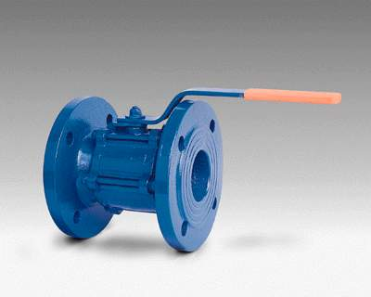
Ball valves vs. PVG
和球阀比较
Ball valves | PVG valves
Ball valves can have a similar price depending on seat material + spec. also require expensive off site machining /低采购成本+高维修成本=高拥有成本 | Flowrox valves can be less expensive and much lower cost of ownership lasting 4-5 times/低拥有成本
Ball valves can either be reduced or full port /球阀也能全孔流通 | Flowrox valves are 100% full bore /100%全管径流通
Ball valves leak after some time, even hard coated valves are subject to wear /由于磨损而引起泄漏 | Flowrox valves are 100% tight /100%关闭
Ball valves are subject to scale and build up of material behind the seat and stem causing wear, leakage and valve failure /阀座后产生物料堆积，引起磨损泄漏损坏。 | Flowrox valves have smooth internals with no place for material to collect, Flowrox valves will always function /内表面光滑，无堆积，长期正常工作。

Slide 9
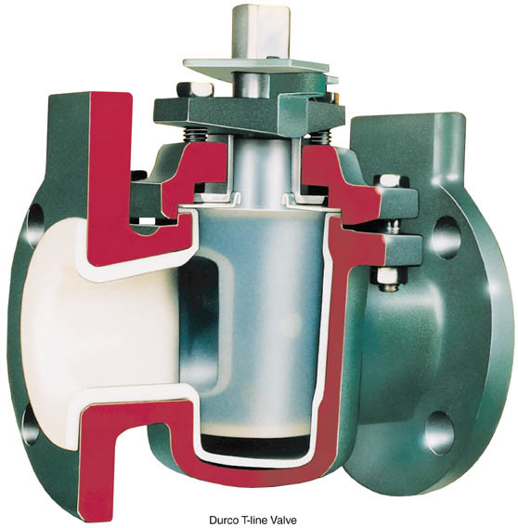
Plug valves vs. PVG
和旋塞阀比较
Plug valves | PVG valves
Plug valves can have a similar price depending on trim but high cost of ownership /相似采购成本，但拥有成本高。 | Flowrox valves can have a competitive purchase price but much lower cost of ownership /虽然采购价略高，但拥有成本低。
Plug valves are not full port causing restricted flow and wear/不能全径流通。 | Flowrox valves are 100% full bore /100%全管径流通
Plug valves are nearly tight when new but after a few operations they tend to leak / wear/新的能关紧，用后易磨损泄漏。 | Flowrox valves are 100% tight /100%关闭
Plug valves are often subject to scale both in the valve and behind the plug, high torque required to open/close /旋塞前后遭磨损，开关扭矩大。 | Flowrox valves have smooth internals with no place for material to collect, Flowrox valves will always function /内表面光滑，无堆积，长期正常工作。

Slide 10
Target applications/应用场合
Reliable isolation valve for:/可靠的关断阀
Tanks/储罐
Thickeners/浓密机
Pumps/泵
Automatic valves/自动控制
Measuring devices/仪表根部阀
Sampling systems/取样分析系统

